Slide 1
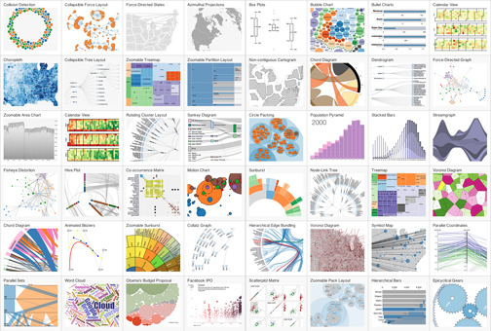
Javascript Integration with FORWARD: Enabling D3.js Applications
Cassio Melo
cmelo@ucsd.edu
UCSD - March 2013

Slide 2
Agenda
Overview of Javascript MV* Frameworks
FORWARD Integration with Javascript
Templating
Javascript API
Guidelines to Integration with D3.js

Slide 3
2010, the Rise of Javascript MV* Frameworks…
AngularJS (Jan. 5, 2010)
CanJS (Feb. 10, 2010)
Knockout.js (Jul. 5, 2010)
Backbone.js (Sep. 30, 2010)
Ember.js (Apr. 30, 2011)
There are many recent projects, WHY?

Slide 4
A Brief Overview of Two Popular Frameworks
AngularJS
Backbone.js

Slide 5

Angular.JS
Relies on HMTL attributes (ng-*, ng-repeat, ng-model, etc)
Two way bindings between view and model

Slide 6
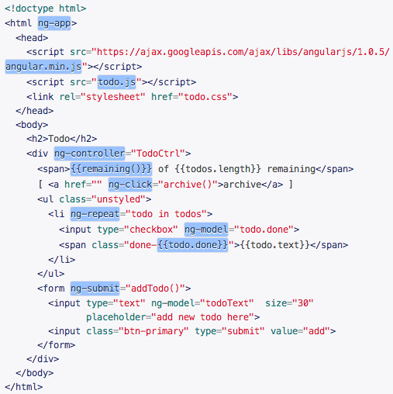
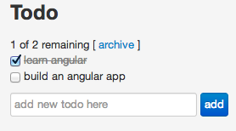
Angular.JS Todo Example

Slide 7
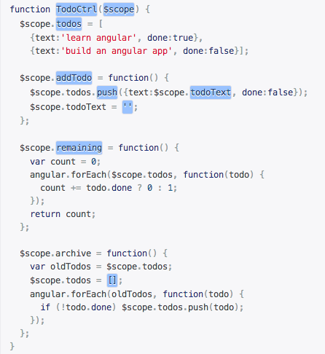
Angular.JS Todo Example

Slide 8
Angula.JS Conclusions
AngularJS has no global state
2-way data binding
Dependency injection framework
Useful services like routing and testing framework
Less code for the developer!

Slide 9
Backbone.js
Backbone.js provides Model and View extensions

Slide 10
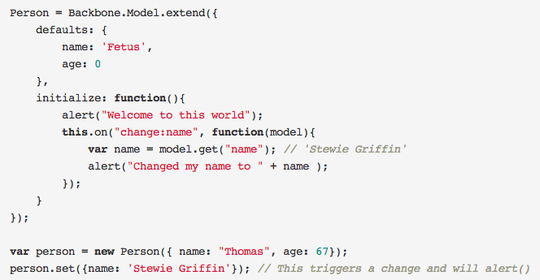
Backbone.js Models

Slide 11
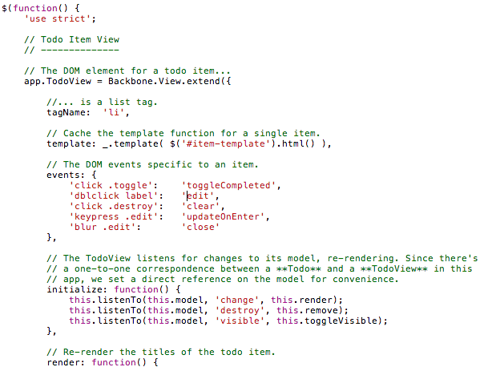
Backbone.js Views
Notes:
related work ember.js angular.js how much is purely model? ho'w is in charge of making correspondences

Slide 12
Backbone.js (call stack)
model instance
model.save{ key: value , …});
backbone.js
computeChanges(model)
Computes which attributes have actually changed
model view
triggerChanges(changes)
Fires all callbacks associated to the change, e.g. “change:title” -> view.render()

Slide 13
Backbone.js Conclusions
Backbone has no direct way of specifying any kind of two way data-binding

Slide 14
FORWARD Integration with Javascript
Goals
Allow javascript/FORWARD [bi-directional] communication
Handle incremental updates accordingly
Popular Design Patterns
Templating – Tags
Templating – Views
Javascript API

Slide 15
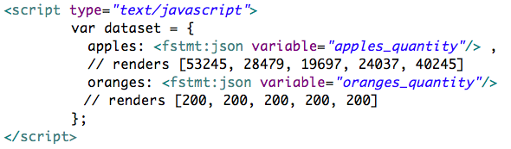
Templating - Tags
It converts variables to json using <fstmt:json> tag

Slide 16
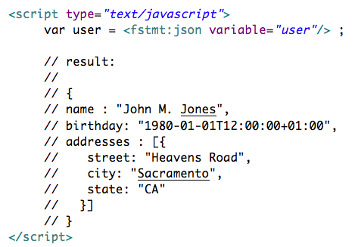
Templating - Tags

Slide 17
Templating - Views
Configure how a JSON (or other) object should be rendered
Pros:
Allows fine tuning of JSON objects
Defines a scope in which objects can be incrementally updated
Cons:
Adds an extra layer of complexity to the developer
Which markup language to use?

Slide 18
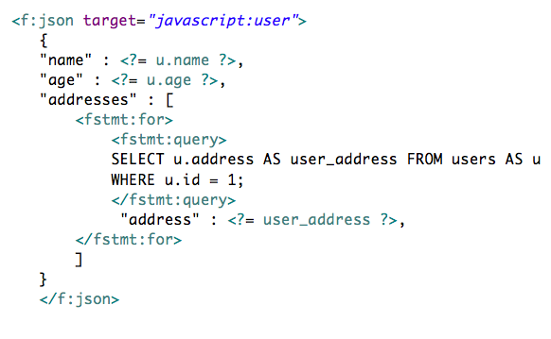
Templating View - Example in JSON

Slide 19
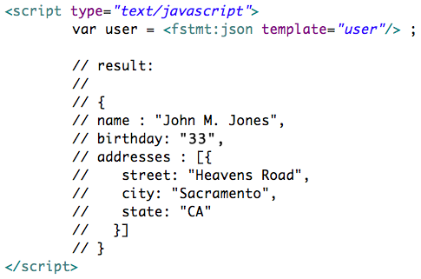
Templating - Example in JSON

Slide 20
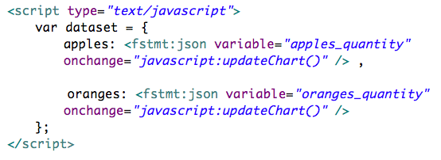
Managing Updates
An observer watches a variable change and triggers javascript function passing the diff as parameter

Slide 21
Templating
Disadvantages of this approach
Because the templating is loosely defined, there is no encapsulation which may compromise readability
Communication only from Forward to Javascript
Solution
A Javascript API which provides a View-Model object

Slide 22
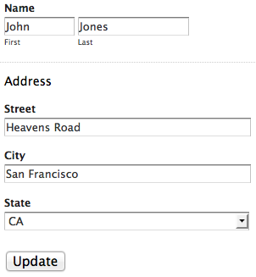
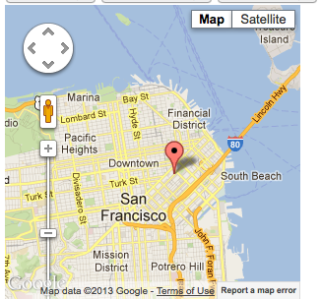
Javascript View-Model
Encapsulates the logic for incremental updates
Allow bi-directional communication

Slide 23
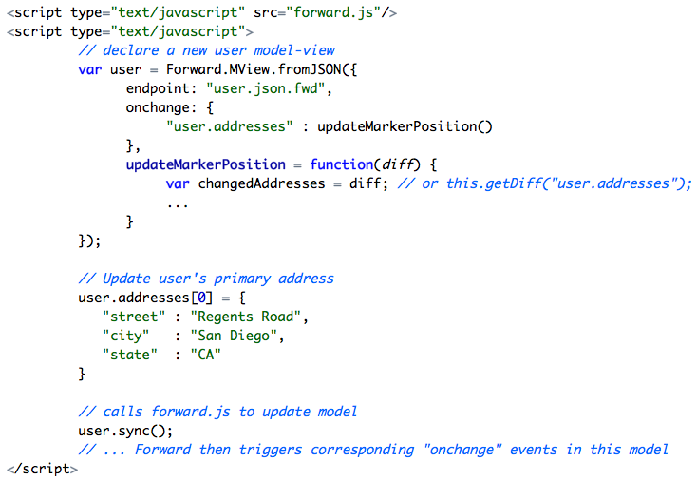
Javascript View-Model

Slide 24
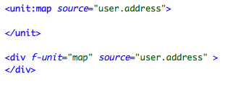
Which syntax?

Slide 25
Javascript Design Patterns to Enable Incremental Updates on Javascript code/library
Week 2

Slide 26
Agenda
Analysis of three Javascript design patterns
MV
MVVM
DOM Observer
Use cases
Visualization library (e.g. d3.js, google Viz)
Google Maps
Arbitrary Javascript code

Slide 27
Model-View

Slide 28
Model-View

Slide 29
Model-ViewView-Model
Example with GMaps

Slide 30

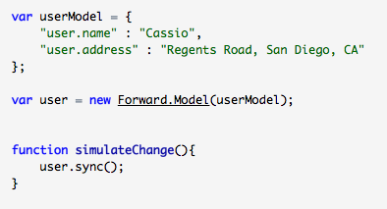
Model-ViewView-Model
Result code:

Slide 31

Forward.Maps.js v0.1
unit type
model.attribute where the markers should be placed
The extension should automatically geocode if address is a string or use lat/lng when available
If address is a collection, it places a marker for each
States are synchronized with the model!

Slide 32
Forward Units Scalability Problem
Creating/Wrapping units requires a lot of time
Solution: Decouple units into separate javascript extensions
There are tons of existing wrappers for javascript (e.g. jquery gmaps, )
Less code! (but it adds more dependencies)
Little knowledge about Forward is necessary for a developer to create a new unit

Slide 33
Javascript DOM observer
Example with D3.js

Slide 34
Javascript DOM observer
Consists in identifying which parts of the DOM document are affected and how - by a javascript code, then reproduce the corresponding changes when data is updated
1)
DOM element (SVG)
2)
Javascript code (D3)
<svg></svg>
var data = [1, 5, 3];
var node = svg.selectAll(”.node")
.data(data)
.enter().append("circle")
...
3)
SVG after javascript code run:
<svg>
<circle …/>
<circle …/>
<circle …/>
</svg>
insert
Notes:
Given a model and an update, find the corresponding view

Slide 35
Javascript DOM observer
4)
Javascript code
5)
SVG after Forward.js update:
data = [1, 5];
// Forward.js manages
to identify the
changes needed
<svg>
<circle …/>
<circle …/>
</svg>
remove
<circle …/>

Slide 36
Javascript DOM observer
Pros
Supports ad-hoc javascript code
Non-intrusive approach (almost no modification in existing code)
Magic (but non-intuitive in some cases)
Cons
Complex to implement
Possibly only works for a very small set of problems

Slide 37
Incremental Updates in Visualizations
For most of visualizations, full rendering is not a problem
In many cases the visual elements need to be resized or repositioned to accommodate a new element (or when removing an existing one)
Incremental update is desirable for smoother user experience and cognitive tracking of changes

Slide 38
Evaluation
Strategy | Integration with existing code | Extensibility | Intuitiveness | Incremental updates handling | Partial renders
MV | X | XXX | XXX | XXX | XX
MVVM | X | XX | XXX | XXX | XX
DOM Observer | XXX | X | X | X | -

Slide 39
Conclusions
Is there a way to provide incremental rendering capabilities for custom javascript code?

Slide 40
Query-oriented

Slide 41
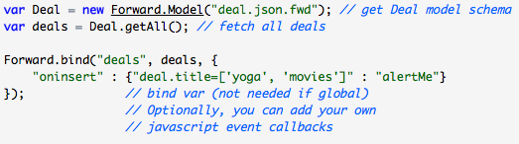
Model-oriented
Automatic generation of CRUD operations
Not so declarative
Custom queries possible (e.g. Deal.query(?

Slide 42
Agenda
1 Forward JSON syntax for Visual Units
1.1 How should map_model be declared?
1.2 What it <j:json> is within a for?
1.3 How to keep track of IDs?

Slide 43
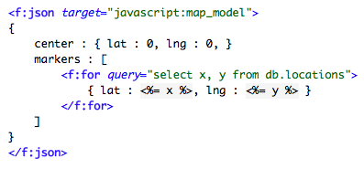
Forward JSON syntax for Visual Units
Issues:
1) How should map_model be declared?
2) What it <j:json> is within a for?
3) How to keep track of IDs?

Slide 44
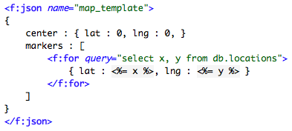
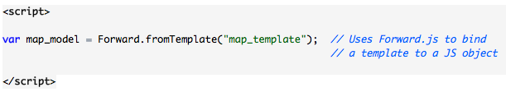
Forward JSON syntax for Visual Units
1.1 How should map_model be declared?
replace target by a name
call the template in JS
Notes:
Advantages: create two-way binding, reusability (same template used in several functions)

Slide 45
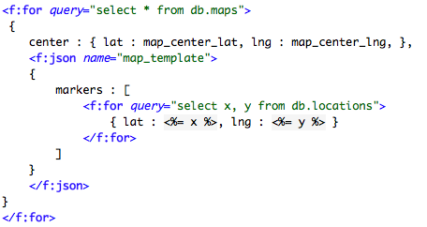
Forward JSON syntax for Visual Units
1.2. What it <f:json> is within a for?
f:json must be
the top most element (root),
comprising all logic to be rendered as JSON

Slide 46
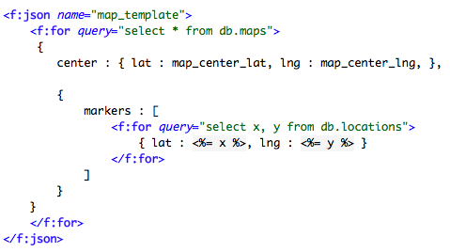
Forward JSON syntax for Visual Units
1.2. What it <f:json> is within a for?

Slide 47
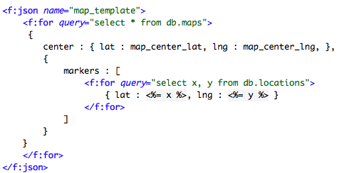
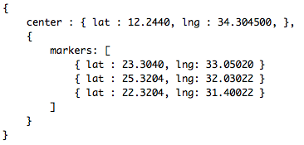
Forward JSON syntax for Visual Units
How to keep track of IDs?
generates

Slide 48
Forward JSON syntax for Visual Units
How to keep track of IDs?
Can a Visual Unit provide an API to javascript?
For i=0 until N
… (i=1)
… (i=2)
map
json

Slide 49
Conclusions
Visual units in Forward should provide a corresponding JS API for a seamlessly integration JS ←→ Forward
This will be easier if the Forward units are in Javascript

Slide 50
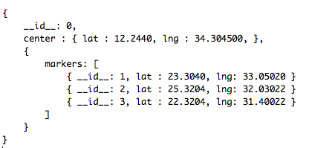
Forward JSON syntax for Visual Units
How to keep track of IDs?
auto generated by forward
consumed in the client

Slide 51
Forward JSON syntax for Visual Units
Demos:
Multiple Gmaps/markers
D3.js and GoogleVis same data source

Slide 52
Javascript + forward
Exploring

Slide 53
Passing data – Page Configuration
Page configuration:

Slide 54
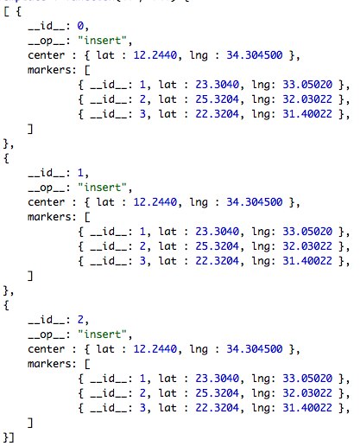
Passing data – Page Configuration
Renders:

Slide 55
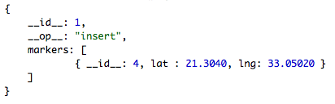
Passing data - Diff
Diff

Slide 56

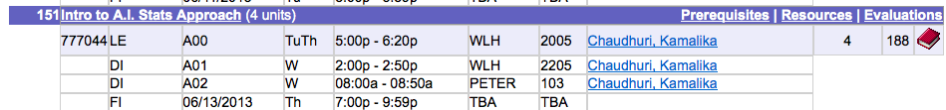

Slide 57
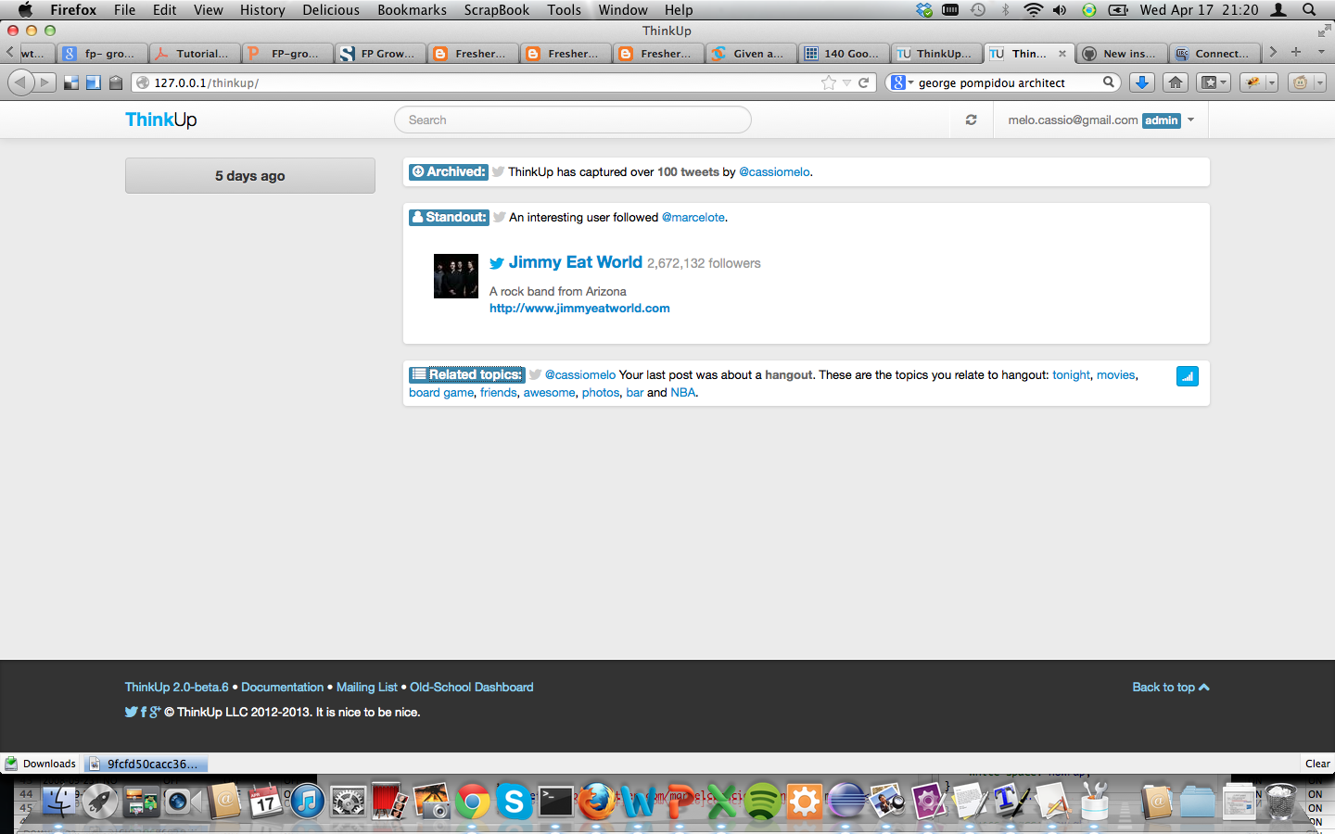

Slide 58
Declaring json in the page configuration

Slide 59
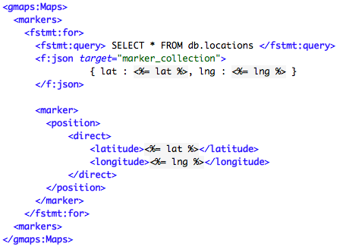

Generating JSON inside a loop

Slide 60
Generating JSON inside a loop
Pros:
Few changes in Forward’s architecture
Cons:
Mix of logic
Complex JSON template within nested queries
What is the scope of marker_collection variable?

Slide 61
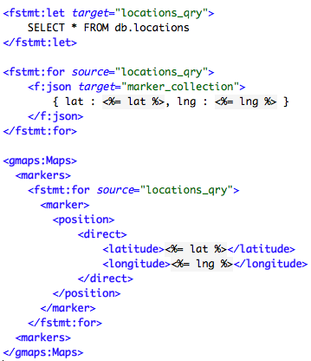
Generating JSON inside a loop
Slight change to improve readability

